Slide 1
The Effect of 9/11 on New York City Wildlife
By Parker Durrah Broadnax

Slide 2
Hypothesis: The fallout from the collapse of the World Trade Center had an adverse effect on surrounding wildlife.

Slide 3
Background on 9/11
The 9/11 attacks on the World Trade Center in New York City were a devastating event that had far-reaching impacts on the environment, including the native wildlife. Manhattan and Brooklyn, two of the most densely populated boroughs in New York City, were directly impacted by the attacks. The following discussion focuses on the effects of the 9/11 attacks on native New York species in Manhattan and Brooklyn.
On September 11, 2001, terrorist attacks destroyed the World Trade Center, resulting in the loss of thousands of lives and causing significant damage to the surrounding environment. The destruction of the Twin Towers released a massive cloud of toxic dust and debris into the atmosphere, which contained a variety of harmful chemicals and substances.

Slide 4
New York City has a Diverse Ecosystem
Home to over 12,000 species of plants, animals, and natural communities, New York is home to a diverse array of species, including birds, mammals, reptiles, and amphibians. The city's parks and natural areas provide essential habitat for many of these species. However, the 9/11 attacks and the ensuing environmental damage had significant impacts on the local wildlife.

Slide 5
Chemical Effects on The City
Chemicals that were released and how it might affect neighbors:
Many of the chemicals released during the 9/11 attacks were harmful to living organisms, including humans and wildlife. These chemicals included asbestos, lead, polycyclic aromatic hydrocarbons (PAHs), and dioxins. The release of these chemicals into the environment posed a significant threat to the health of both people and wildlife in the surrounding areas.
Dioxin and its effect on animals:
Dioxin is a highly toxic chemical that was released during the 9/11 attacks. Studies have shown that animals exposed to dioxins can experience alterations in sex hormones, reductions in sperm count, and increased rates of miscarriages. The concentrations of dioxin recorded at the World Trade Center site were the highest ever recorded anywhere in the world.

Slide 6
Chemical Effects on The City Continued
Acid rain and its effect on plants and natural communities:
The release of sulfur dioxide and nitric oxides during the 9/11 attacks contributed to the formation of acid rain. Acid rain can have significant impacts on plants and natural communities, including damage to leaves, reduced growth, and decreased nutrient uptake. It can also alter soil chemistry and affect the availability of food and resources for organisms.

Slide 7
Scope of Project
Limited to New York and Kings County (Brooklyn and Manhattan)
Only observations between 1991 and 2011

Slide 8
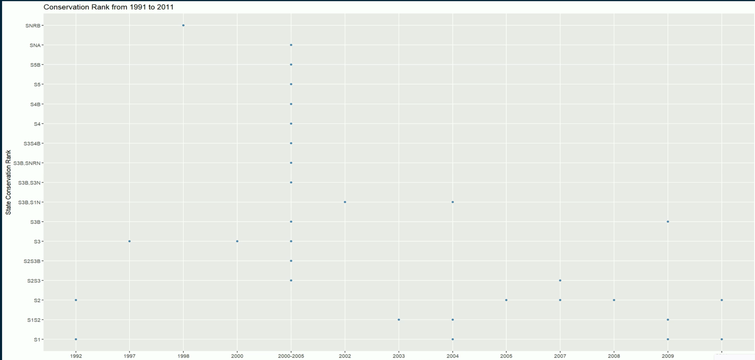
Scatterplot: State conservation rank by year

Slide 9
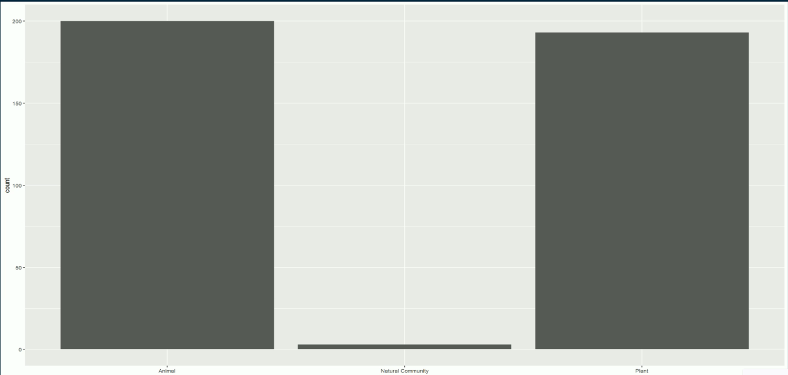
Distribution of Flora and Fauna in New York City

Slide 10
(lm(State.Conservation.Rank~Year.Last.Documented,data=cur_obs)
Linear regression model

Slide 11
Future Research:
Future research should focus on investigating the precise effects of sulfur dioxide and nitrogen oxides released into the atmosphere on plants and natural communities. Controlled studies can help simulate the conditions created by 9/11 and evaluate the impacts on various species and their habitats in Manhattan and Brooklyn. Long-term monitoring and assessments are necessary to understand the potential long-lasting consequences on native New York species and inform conservation and management strategies specific to these areas.

Slide 12
Conclusion
The 9/11 attacks had a profound impact on the environment, including native New York species in Manhattan and Brooklyn. The release of hazardous chemicals, such as dioxins, and the formation of acid rain from sulfur dioxide and nitric oxides raised concerns about the well-being of wildlife and natural communities. However, establishing a direct causal link between the attacks and changes in native species populations is challenging due to the multitude of factors influencing ecosystems. Further research is needed to understand the specific effects of these chemicals on plants and wildlife in Manhattan and Brooklyn, enabling effective conservation measures and long-term monitoring to protect and restore the native New York species and their habitats.

Slide 13
THANK YOU

